Slide 1


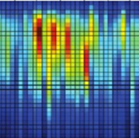
2048*1
FC_Layer
High: 1
Low: 0
Scale
Channel
Channel
Ft ~ Ft+M-1
Pool3: 2*2*2
Frame
Input: 32 * 32 * 6
if M = 6
Pool1: 2*2*2
Conv2-1: 64 @ 3*3*3
Conv2-2: 64 @ 3*3*3
Pool2: 2*2*2
Conv1-1: 32 @ 3*3*3
Conv1-2: 32 @ 3*3*3
Conv3-1: 128 @ 3*3*3
Conv3-2: 128 @ 3*3*3

